Slide 1
Spac3 Invad3rs
WE COME IN PEACE

Slide 2
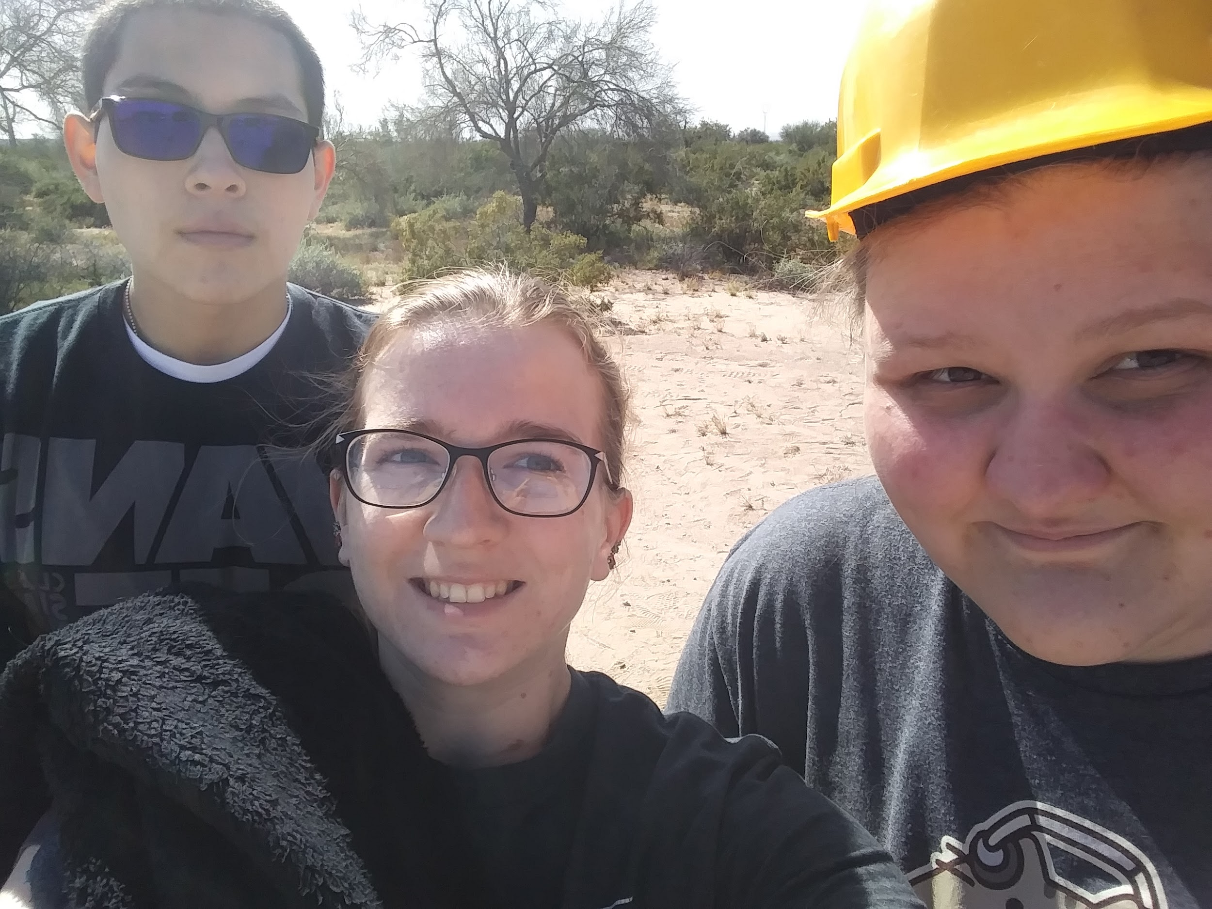
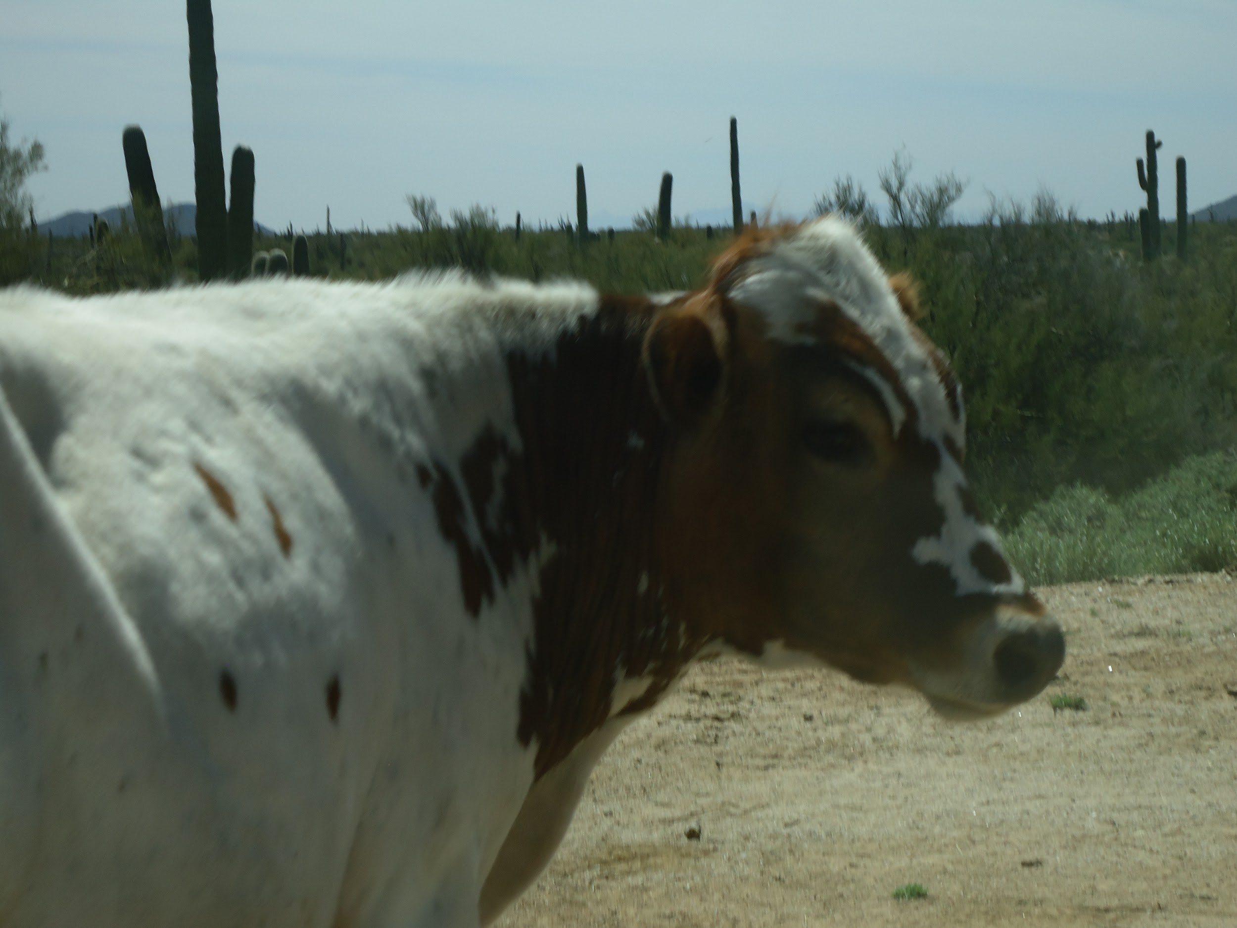
Team
Members
Cerah Schaffer
Alexis Haas
Antonio Varela
Random Cow

Slide 3
Goal for Flights
Fall 2018 Goal: Our team’s goal is to compare the effectiveness of two types of UV protection (lens and cloth) at different altitudes and to capture a clear video of the launch from different angles
Spring 2019 Goal: Our team’s goal is to compare the effectiveness of two types of UV protection (lens and cloth) at different altitudes, capture a clear video of the launch from different angles and record measurable factors such as barometric pressure and temperature.

Slide 4
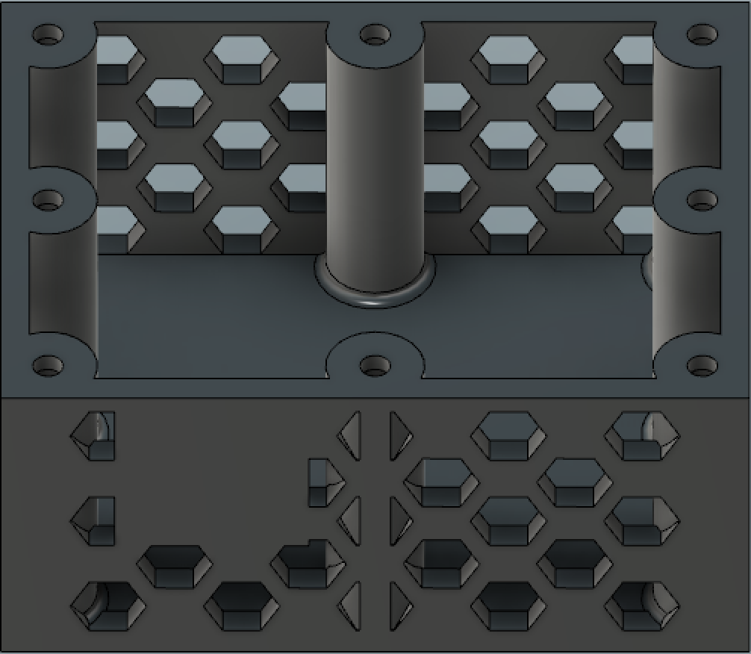
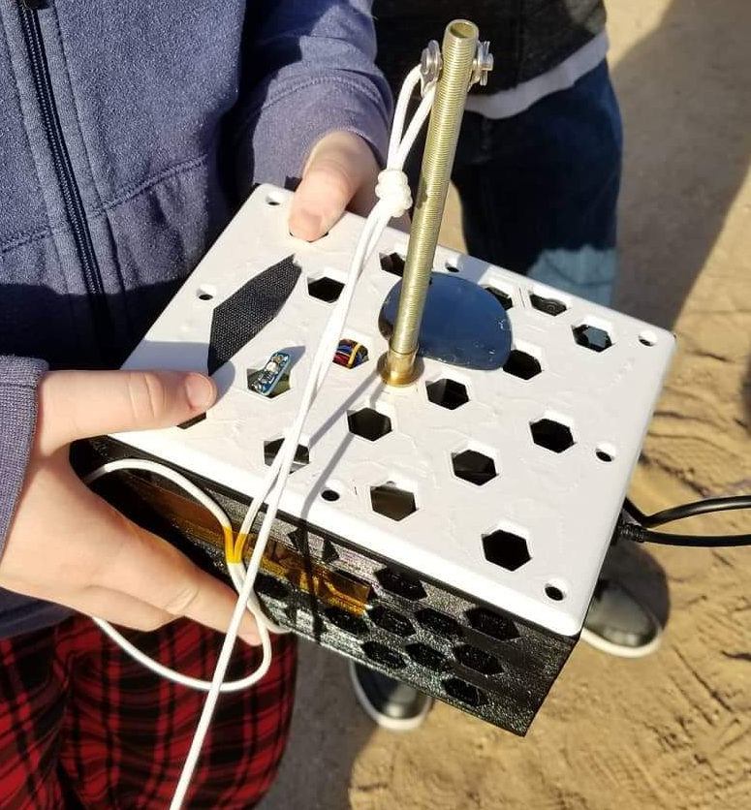
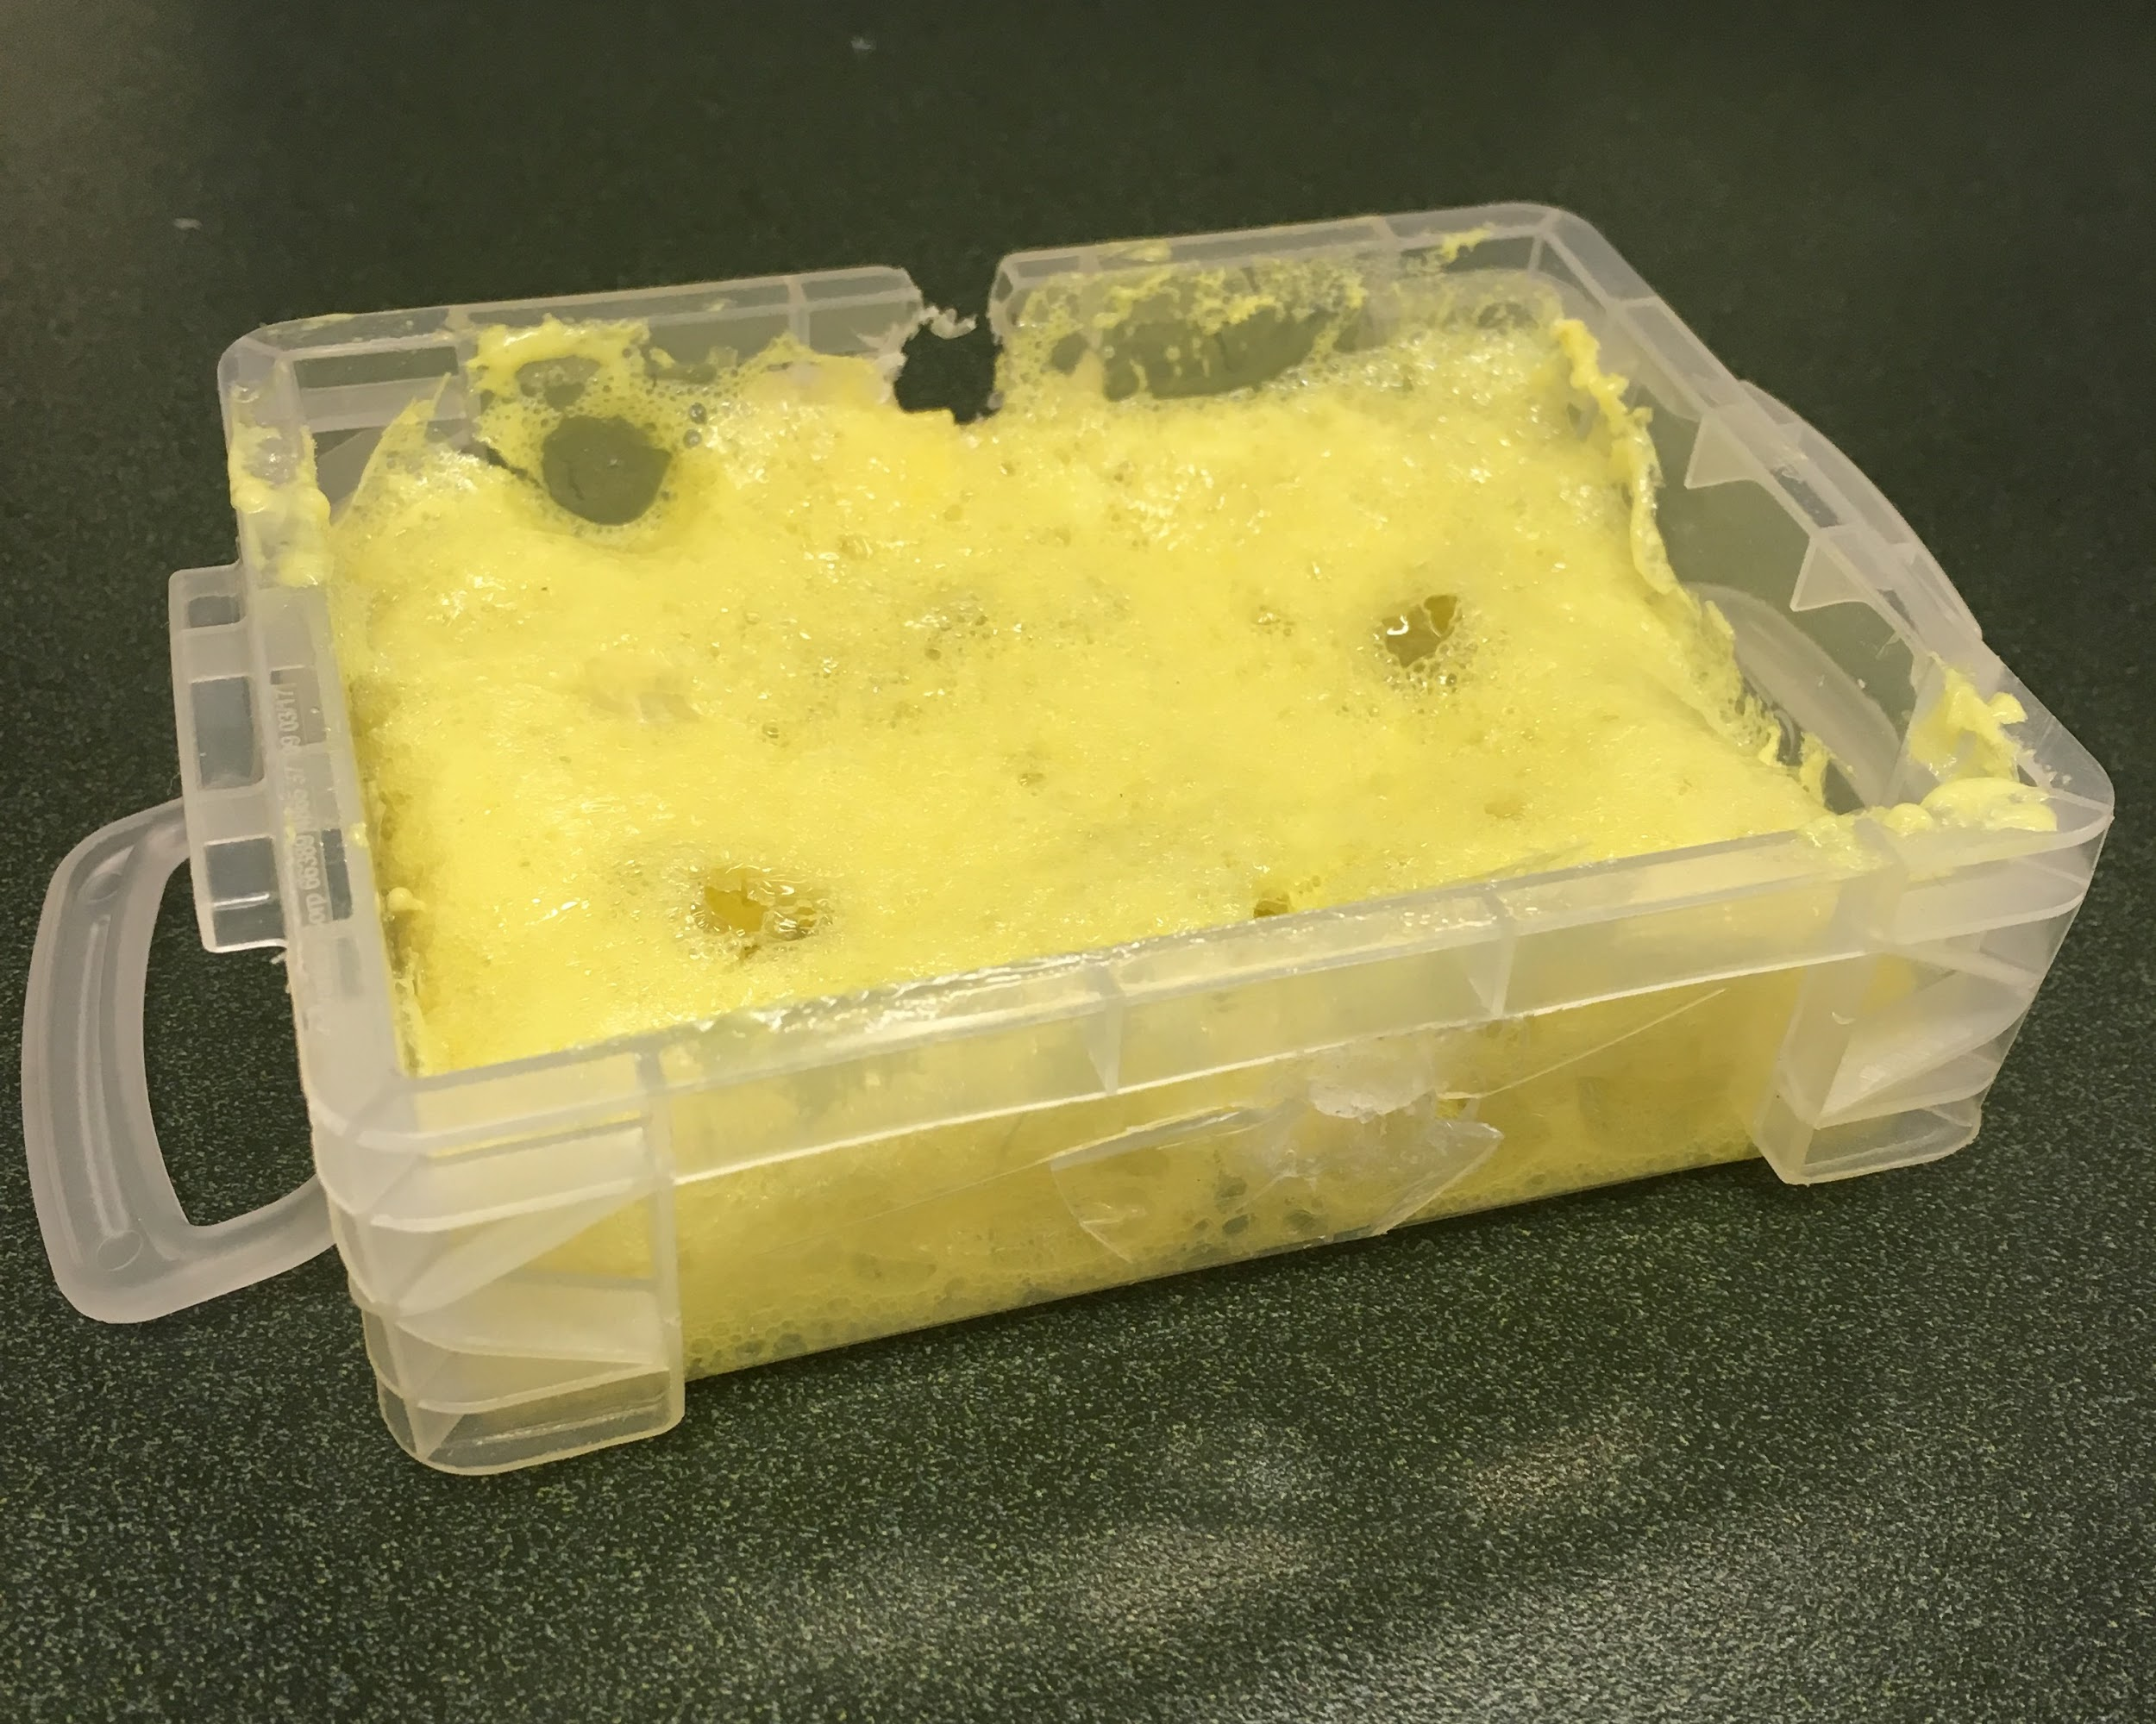
Fall 2018 Box
3D Design using Fusion360
Built of PETG
Hexagonal holes used to reduce weight
Great Stuff to insulate pi

Slide 5
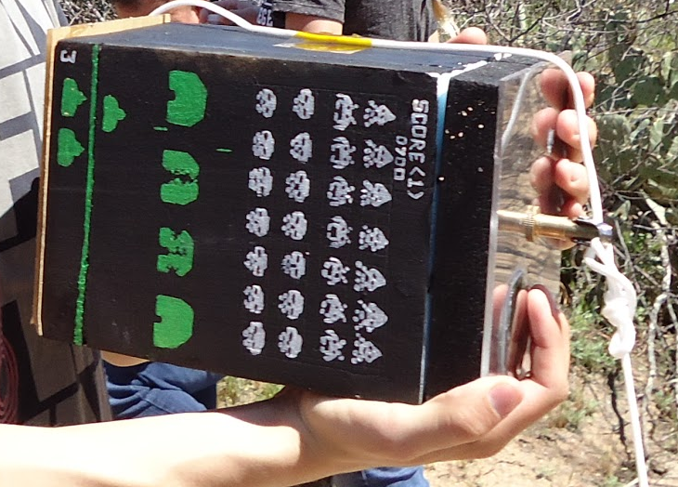
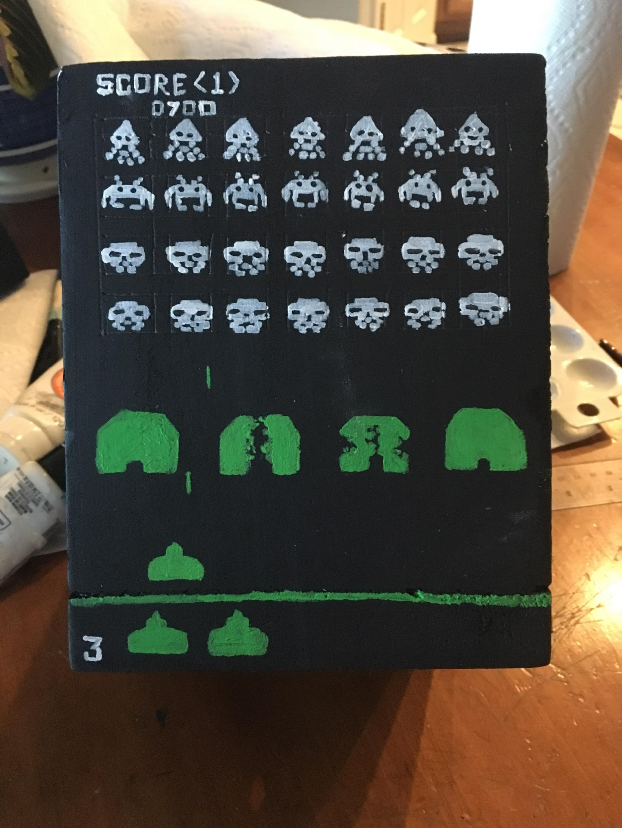
Spring 2019 Box
R5 Foam insulation
Great Stuff to glue box together
Gorilla Glue to hold cameras in place
Foam clay to hold the sensors
Shatterproof plastic on top and bottom

Slide 6
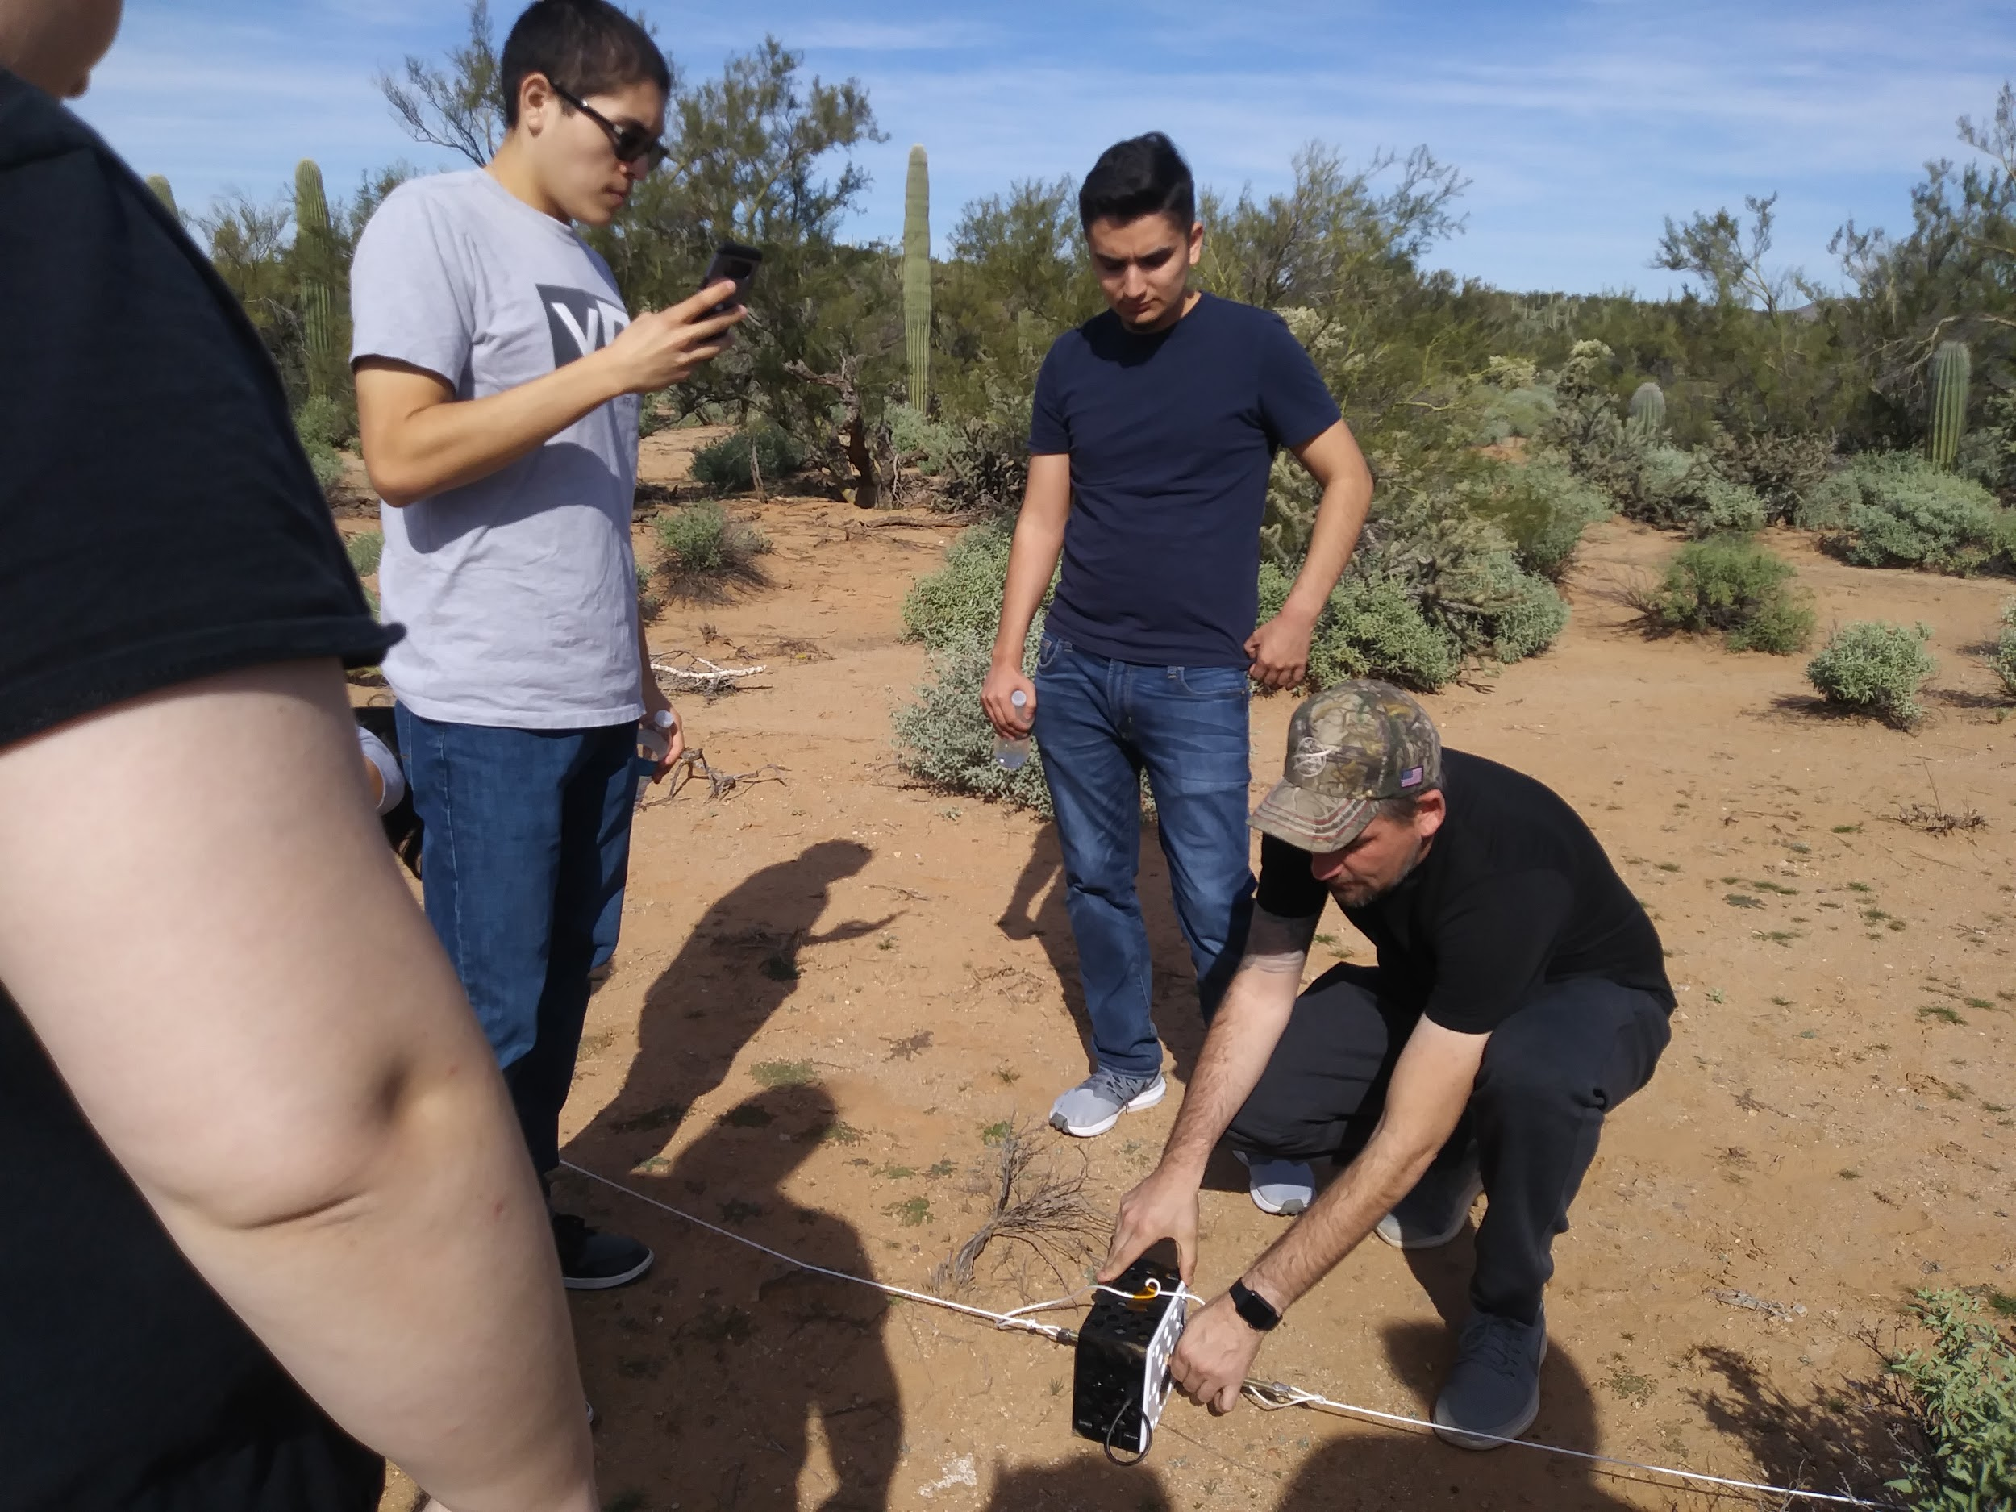
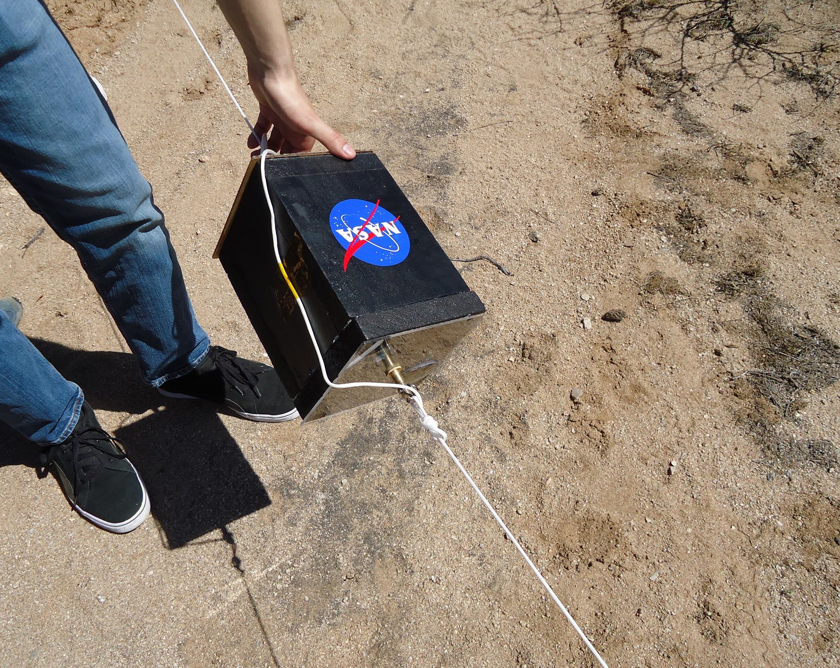
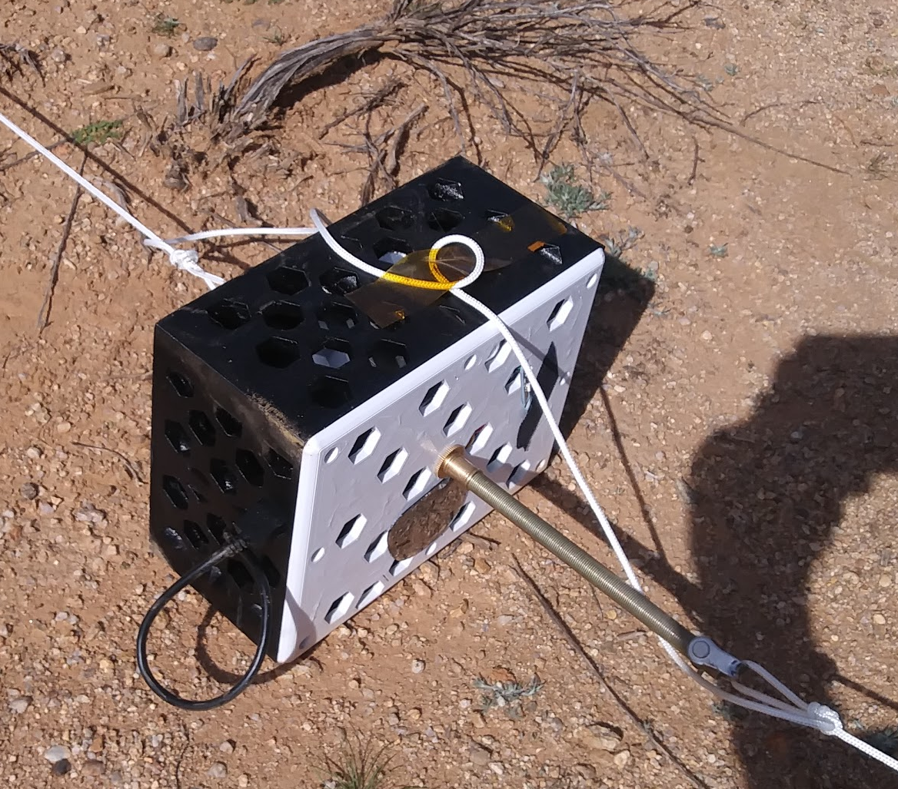
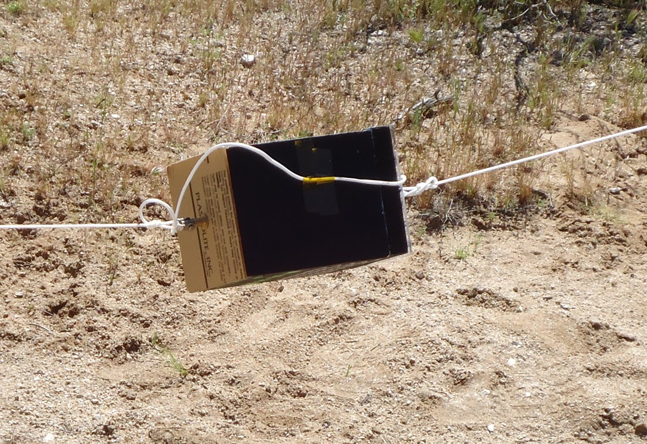
Recovery

Slide 7
Electrical
Fall 2018
Spring 2019
Raspberry Pi Zero
5V 1A battery
Firefly cameras 30 fps (2880 X 2160) with individual batteries
Three UV light sensors (GUVA-S12SD), a digital to analog converter chip, and a pi senseHat
Raspberry Pi 3B
5V 1A battery
Firefly cameras 30 fps (2880 X 2160) with individual batteries
Three UV light sensors (GUVA-S12SD), a digital to analog converter chip, and a altimeter/temperature/pressure sensor

Slide 8
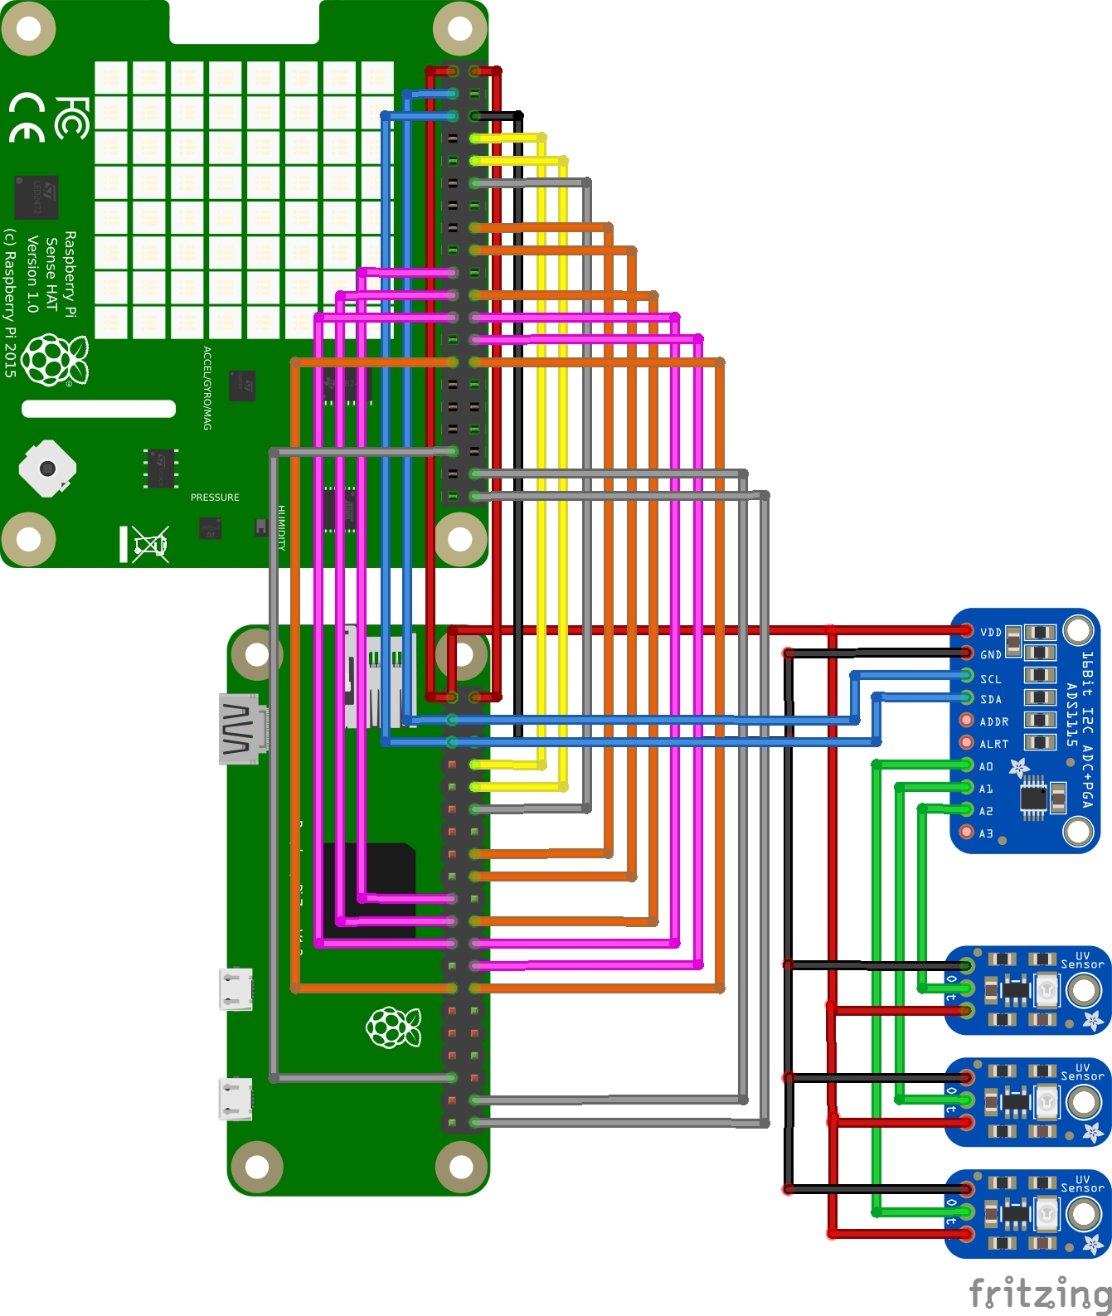
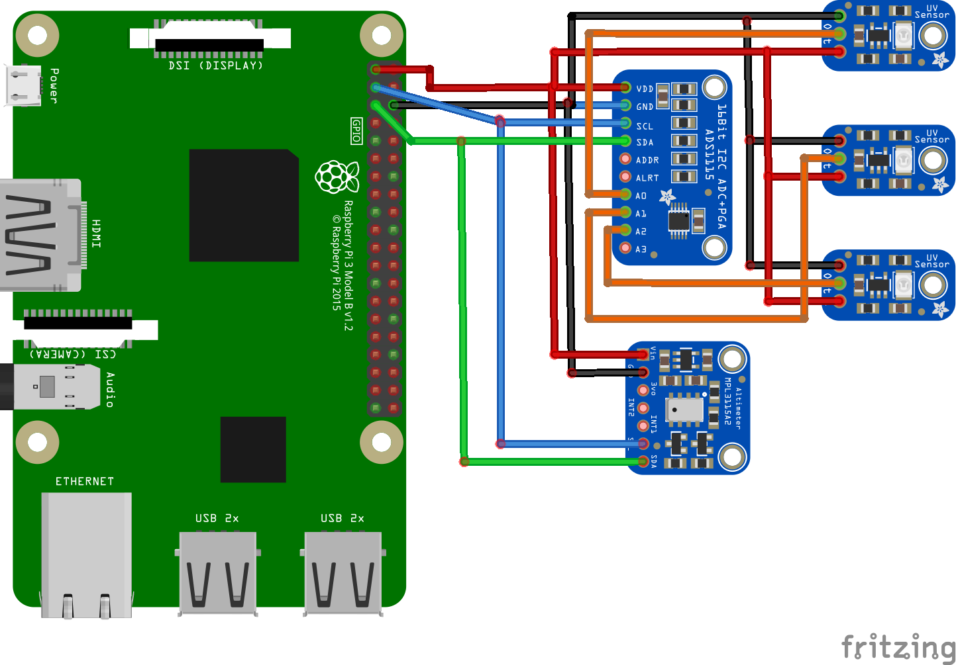
Electrical
Fall 2018
Spring 2019
Raspberry pi zero could not power the SenseHat

Slide 9
Software
We used a Raspberry Pi 3B to collect our data, and our selected syntax was Python.
Both programs were set to record data once every half second.
Recorded:
Altitude, Temperature, Pressure (Spring)
UV Index (Fall and Spring)
Once the data was collected our plans were to move it over to an excel file to analyze it further.

Slide 10
DATA
Fall 2018: We recorded 30 mins of UV data but we waited too long to analyze it, so the conversions between voltage values and UV index were forgotten/lost. We did not use the SenseHat due to the pi zero being unable to run it and weight constraints. No data was able to be salvaged.
Spring 2019: We were unable to get any sensor data because of a critical failure of the UV index program in first minute of flight and an infinite loop in altimeter program that over-wrote data. No data was able to be salvaged

Slide 11
Ideas for the Future
Gyro stabilization
Wider camera lenses
Wider view to better capture the edge between space and Earth
Everything work using one battery
One switch on outside to start everything

Slide 12
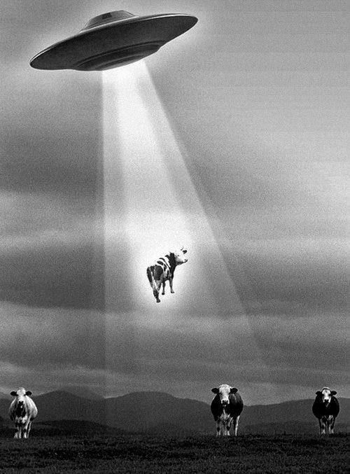
Thank You
AZ Space Grant Consortium
Michelle Coe
ANSR Team
Steven Thomas
Clayton Jacobs
NASA ASCEND Mentor
Michelle Breaux
Tech Lab
Darryl Ferra
Ray Surdilla

